Slide 1
CS F222: Discrete Structures
for
Computer Science
Topic: Counting
Dr. Raghunath Reddy

Slide 2

Basics of Counting
Suppose that a password on a computer system consists of six, seven, or eight characters. Each of these characters must be a digit or a letter of the alphabet. Each password must contain at least one digit. How many such passwords are there?
Discrete Probability: count the successful outcomes of experiments and all the possible outcomes of these experiments to determine probabilities of discrete events
Time Complexity: the number of operations used by an algorithm
Product rule and Sum rule

Slide 3
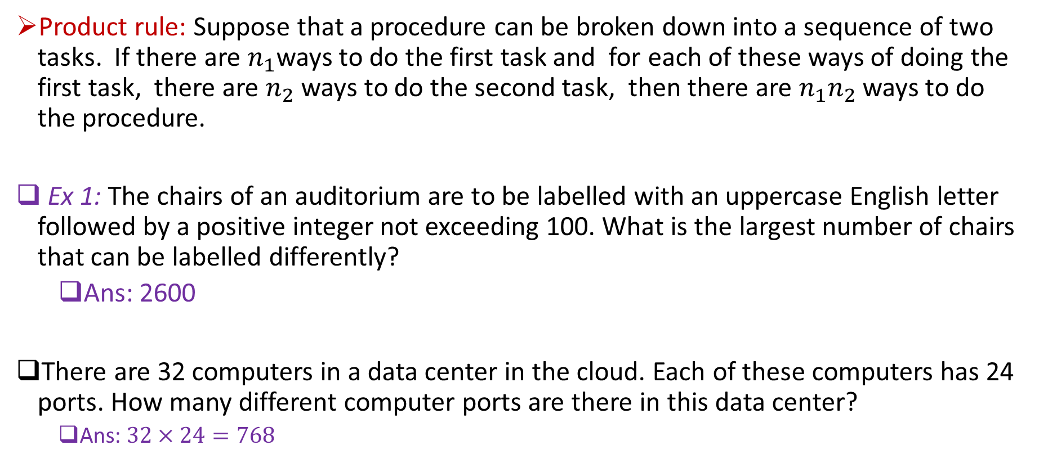
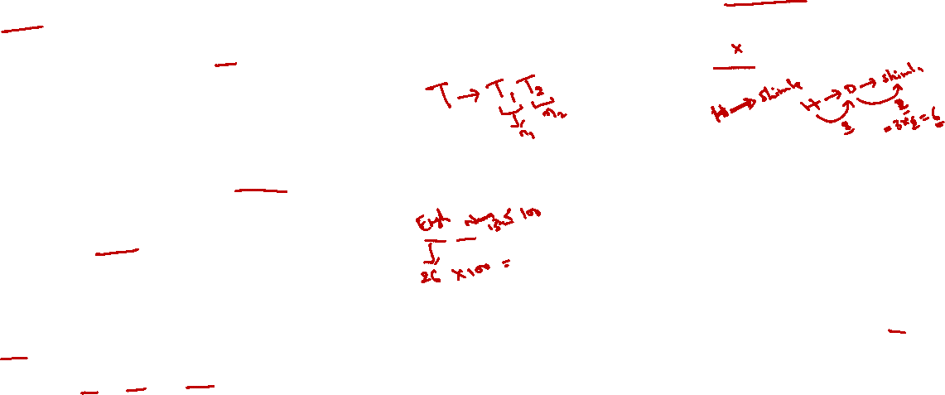
Product rule
Product rule: Suppose that a procedure can be broken down into a sequence of two tasks. If there are $n_{1}$ways to do the first task and for each of these ways of doing the first task, there are $n_{2}$ ways to do the second task, then there are $n_{1}n_{2}$ ways to do the procedure.
Ex 1: The chairs of an auditorium are to be labelled with an uppercase English letter followed by a positive integer not exceeding 100. What is the largest number of chairs that can be labelled differently?
  Ans: 2600
There are 32 computers in a data center in the cloud. Each of these computers has 24 ports. How many different computer ports are there in this data center?
  Ans: $32×24=768$

Slide 4


Product rule (generalization)
Suppose that a procedure is carried out by performing the tasks $T_{1}, T_{2},…, T_{m}$in sequence. If each task $T_{i}, i = 1, 2,…, m$, can be done in $n_{i}$ ways, regardless of how the previous tasks were done, then there are $n_{1}× n_{2}×⋯×n_{m}$ ways to carry out the procedure.

Slide 5

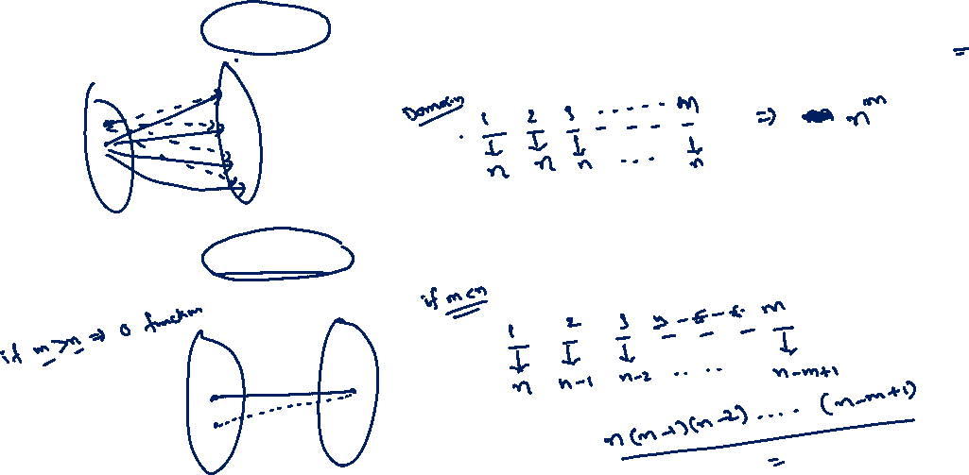
Examples:
How many functions are there from a set with $m$ elements to a set with $n$elements?
How many one-to-one functions are there from a set with $m$ elements to one with $n$ elements ?

Slide 6

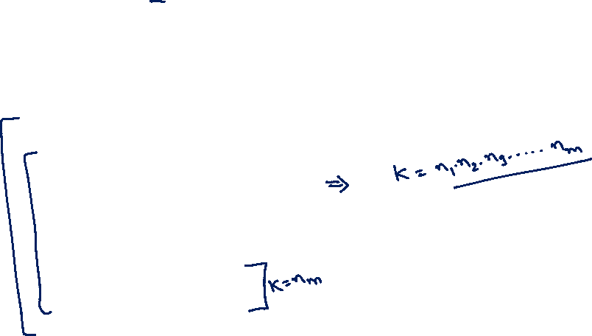
Examples:
What is the value of $k$after the following code has been executed ? (where $n_{1}, n_{2},…, n_{m}$ are positive integers)

Slide 7
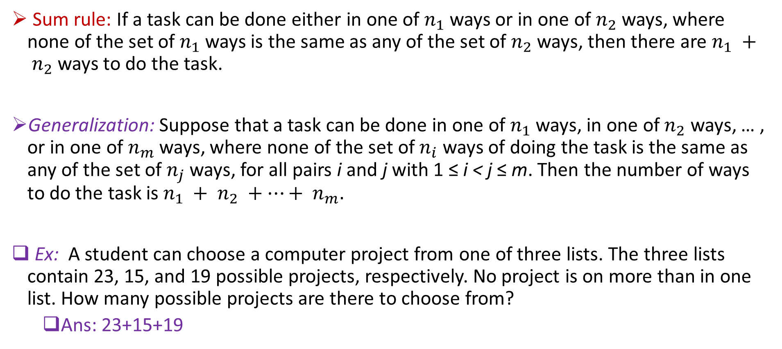

Sum rule
Sum rule: If a task can be done either in one of $n_{1}$ ways or in one of $n_{2}$ ways, where none of the set of $n_{1}$ ways is the same as any of the set of $n_{2}$ ways, then there are $n_{1} + n_{2}$ways to do the task.
Generalization: Suppose that a task can be done in one of $n_{1}$ ways, in one of $n_{2}$ ways, … , or in one of $n_{m}$ ways, where none of the set of $n_{i}$ ways of doing the task is the same as any of the set of $n_{j}$ ways, for all pairs i and j with 1 ≤ i < j ≤ m. Then the number of ways to do the task is $n_{1} + n_{2} +⋯+ n_{m}.$
Ex: A student can choose a computer project from one of three lists. The three lists contain 23, 15, and 19 possible projects, respectively. No project is on more than in one list. How many possible projects are there to choose from?
  Ans: 23+15+19

Slide 8

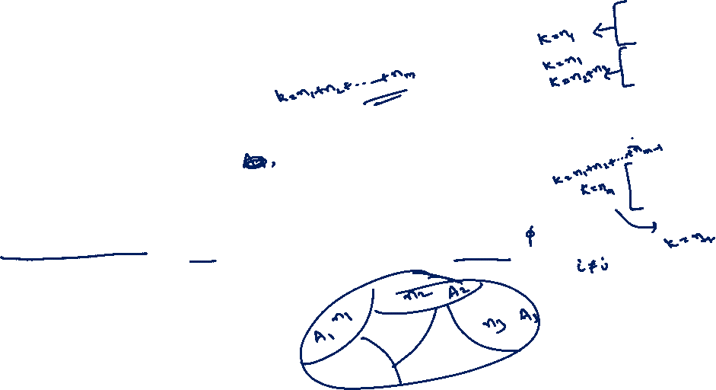
Sum rule
What is the value of $k$after the following code has been executed ? (where $n_{1}, n_{2},…, n_{m}$ are positive integers)
Sum rule in terms of sets:

Slide 9

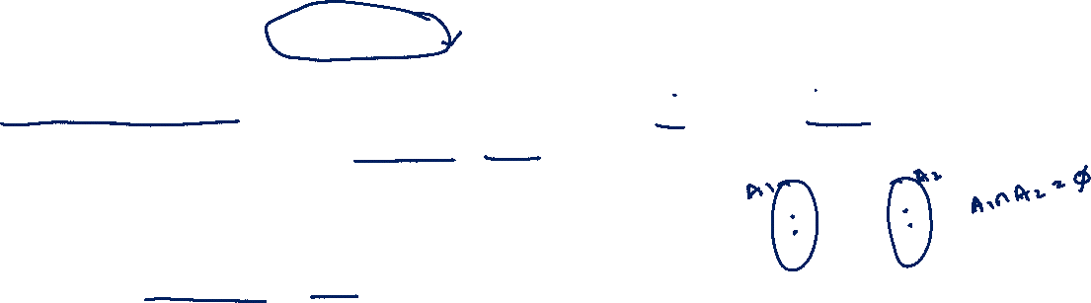

Principle of Inclusion-Exclusion
THE SUBTRACTION RULE: If a task can be done in either $n_{1}$ ways or $n_{2}$ ways, then the number of ways to do the task is $n_{1} + n_{2}$ minus the number of ways to do the task that are common to the two different ways.
Set theory : $\left|A_{1}∪A_{2}\right|=\left|A_{1}\right|+\left|A_{2}\right|−|A_{1}∩A_{2}|$

Slide 10
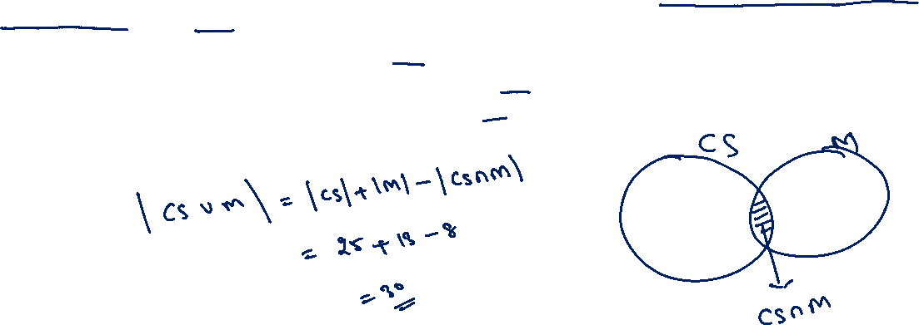
Principle of Inclusion-Exclusion
Example: In a discrete mathematics class every student is a major in computer science or mathematics, or both. The number of students having computer science as a major (possibly along with mathematics) is 25; the number of students having mathematics as a major (possibly along with computer science) is 13; and the number of students majoring in both computer science and mathematics is 8. How many students are in this class?

Slide 11
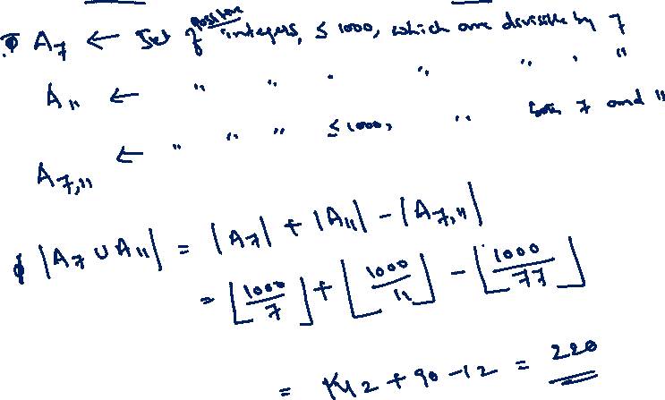
Principle of Inclusion-Exclusion
Example: How many positive integers not exceeding 1000 are divisible by 7 or 11 ?

Slide 12



Generalized Principle of Inclusion-Exclusion
For three sets: $\left|A∪B∪C \right|?$
$$\left|A∪B∪C\right|=\left|A\right|+\left|B\right|+\left|C\right|−\left|A∩B\right|−\left|B∩C\right|−\left|A∩C\right|+|A∩B∩C|$$

Slide 13
Generalized Principle of Inclusion-Exclusion
Example: A total of 1232 students have taken a course in Spanish, 879 have taken a course in French, and 114 have taken a course in Russian. Further, 103 have taken courses in both Spanish and French, 23 have taken courses in both Spanish and Russian, and 14 have taken courses in both French and Russian. If 2092 students have taken at least one of Spanish, French, and Russian, how many students have taken a course in all three languages?

Slide 14

Generalized Principle of Inclusion-Exclusion

Slide 15
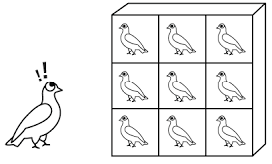
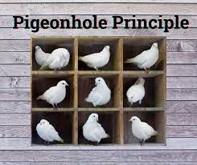
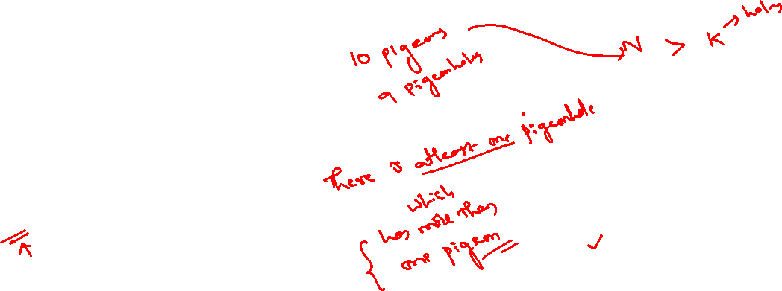

Slide 16
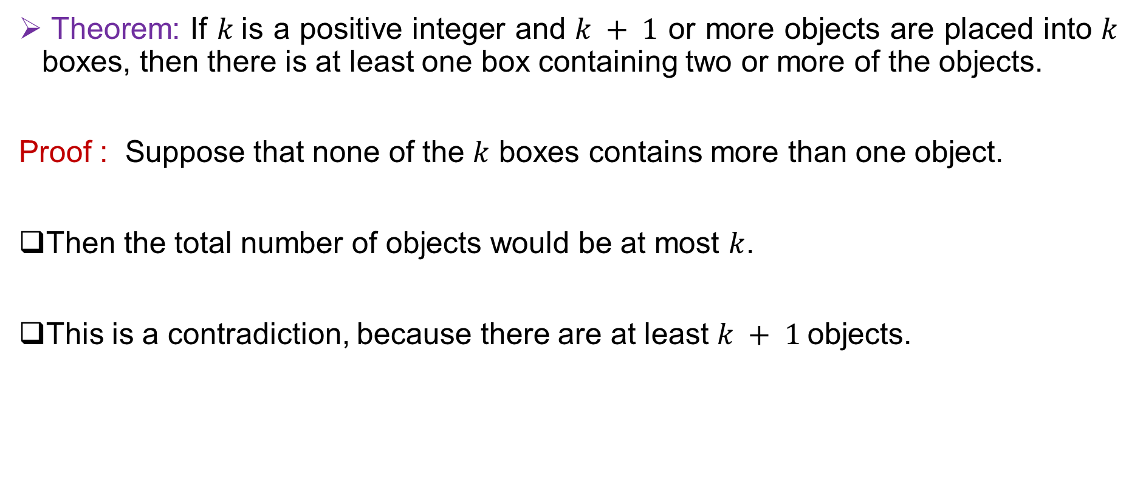
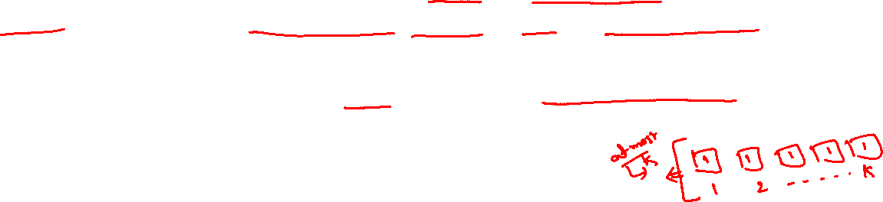
The Pigeonhole Principle
Theorem: If $k$is a positive integer and $k + 1$ or more objects are placed into $k$ boxes, then there is at least one box containing two or more of the objects.
Proof : Suppose that none of the $k$ boxes contains more than one object.
Then the total number of objects would be at most $k$.
This is a contradiction, because there are at least $k + 1$objects.

Slide 17
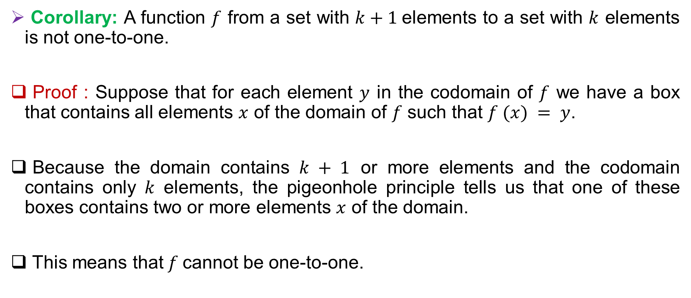
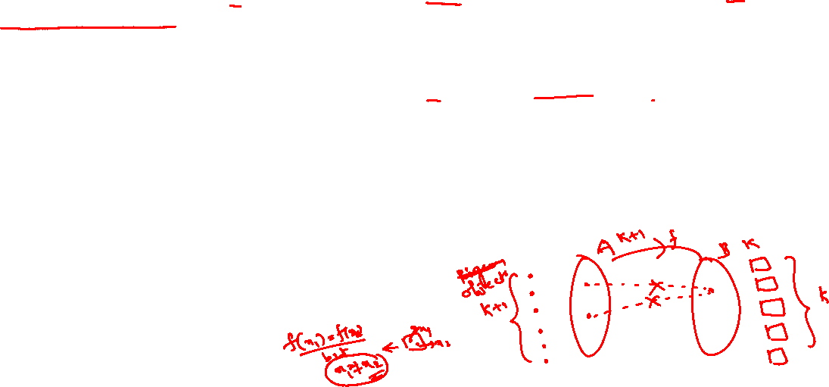
The Pigeonhole Principle
Corollary: A function $f$ from a set with $k+1$elements to a set with $k$ elements is not one-to-one.
Proof : Suppose that for each element $y$ in the codomain of $f$ we have a box that contains all elements $x$ of the domain of $f$ such that $f (x) = y$.
Because the domain contains $k + 1$ or more elements and the codomain contains only $k$ elements, the pigeonhole principle tells us that one of these boxes contains two or more elements $x$ of the domain.
This means that$f$cannot be one-to-one.

Slide 18
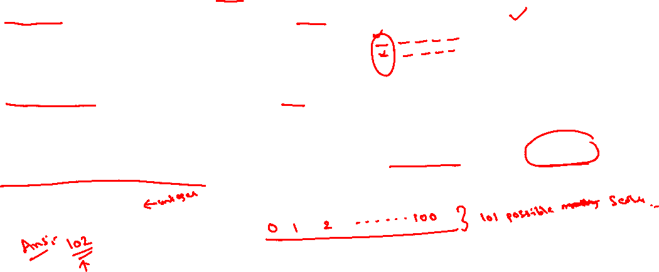
Examples:
Among any group of 367 people, there must be at least two with the same birthday, because there are only 366 possible birthdays.
In any group of 27 English words, there must be at least two that begin with the same letter, because there are 26 letters in the English alphabet.
How many students must be in a class to guarantee that at least two students receive the same score on the final exam, if the exam is graded on a scale from 0 to 100 points?

Slide 19

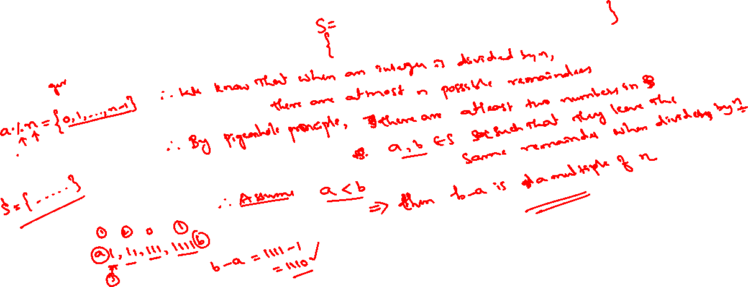



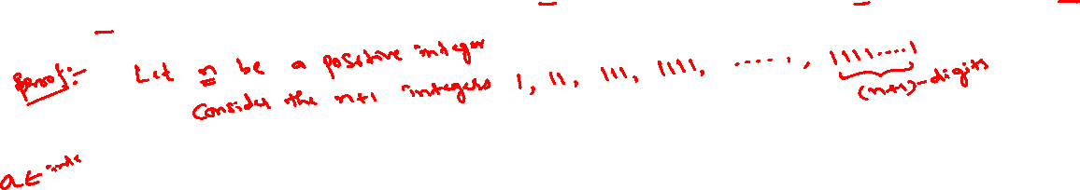
Examples:
Show that for every positive integer $n$ there is a multiple of $n$that has only $0$s and 1s in its decimal expansion.

Slide 20
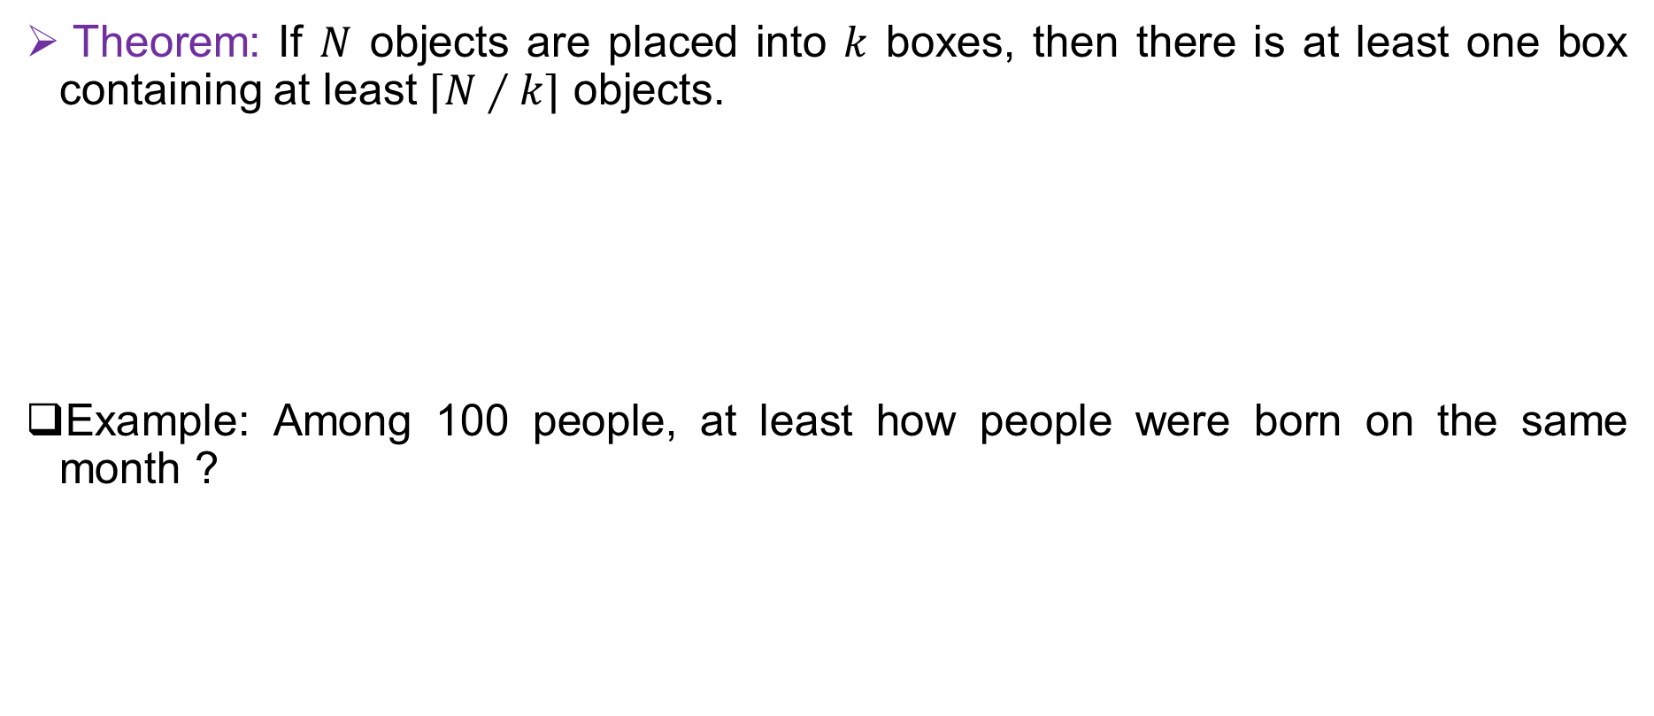

The Generalized Pigeonhole Principle
Theorem: If $N$ objects are placed into $k$ boxes, then there is at least one box containing at least $⌈N∕k⌉$ objects.
Example: Among 100 people, at least how people were born on the same month ?

Slide 21
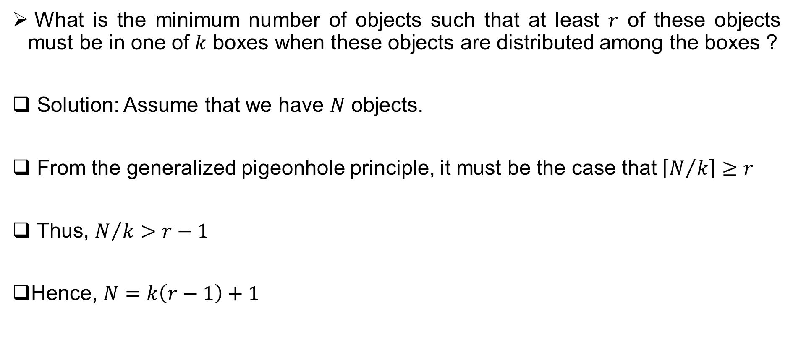
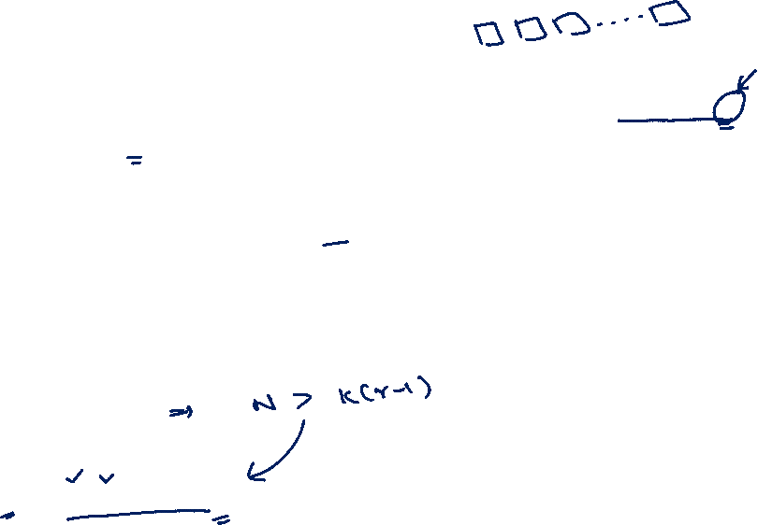
Important question
What is the minimum number of objects such that at least $r$ of these objects must be in one of $k$ boxes when these objects are distributed among the boxes ?
Solution: Assume that we have $N$ objects.
From the generalized pigeonhole principle, it must be the case that$\left\lceil N/k\right\rceil ≥r$
Thus, $N/k>r−1$
Hence, $N=k\left(r−1\right)+1$

Slide 22
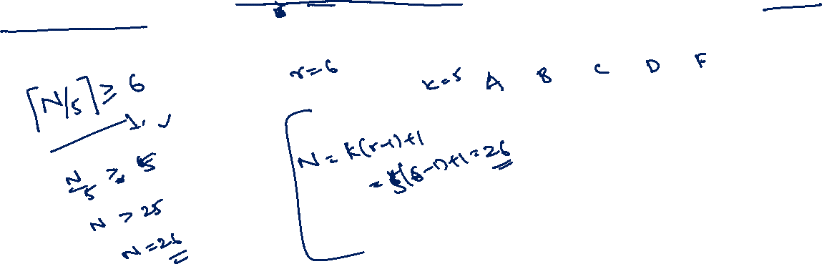
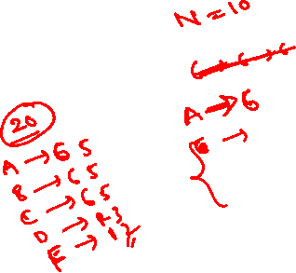
Example:
What is the minimum number of students required in a discrete mathematics class to be sure that at least six will receive the same grade, if there are five possible grades, A, B, C, D, and F?

Slide 23
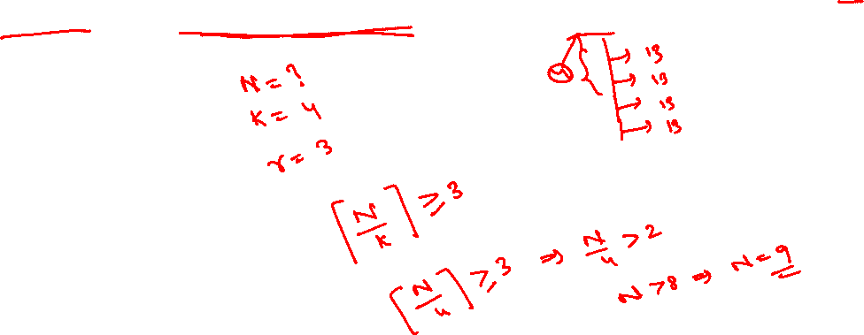
Example:
How many cards must be selected from a standard deck of 52 cards to guarantee that at least three cards of the same suit are selected?

Slide 24
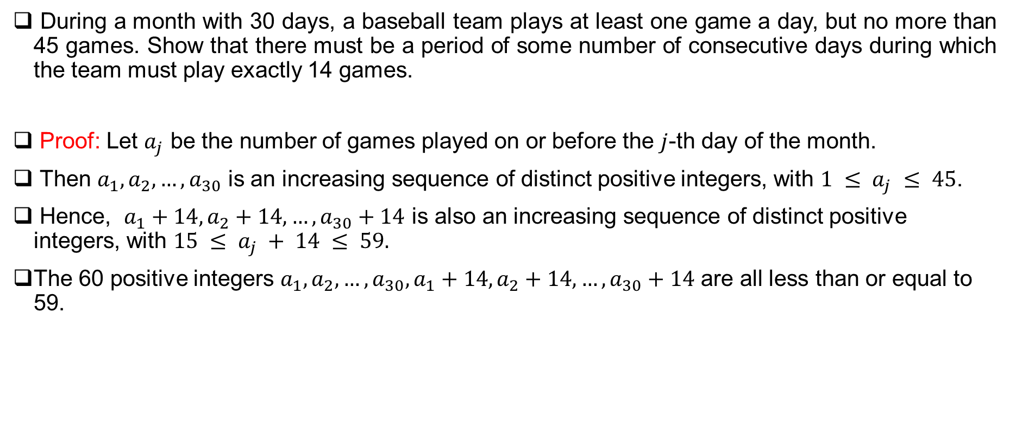

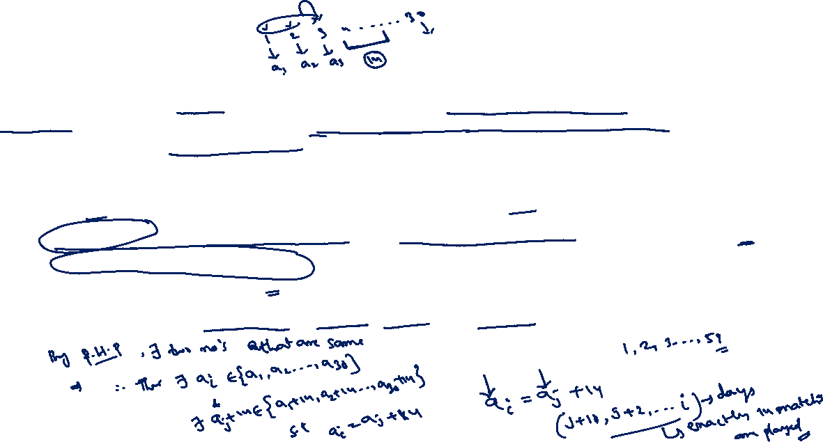
Examples:
During a month with 30 days, a baseball team plays at least one game a day, but no more than 45 games. Show that there must be a period of some number of consecutive days during which the team must play exactly 14 games.
Proof: Let $a_{j}$ be the number of games played on or before the $j$-th day of the month.
Then $a_{1}, a_{2},…, a_{30}$ is an increasing sequence of distinct positive integers, with $1 ≤ a_{j} ≤ 45$.
Hence, $a_{1}+14, a_{2}+14,…, a_{30}+14$ is also an increasing sequence of distinct positive integers, with $15 ≤ a_{j} + 14 ≤ 59.$
The 60 positive integers $a_{1}, a_{2},…, a_{30}, a_{1}+14, a_{2}+14,…, a_{30}+14$ are all less than or equal to 59.

Slide 25
Thank You!!

